Slide 1
19MAT105 EVALUATION-4
ASSIGNMENT-2

Slide 2
BATCH A TEAM 11

Slide 3
TEAM MEMBERS:-
01
VIKHYAT BANSAL
02
VIGNESH M.
CB.EN.U4AIE21076
CB.EN.U4AIE21075
03
04
MARREDDY MOHIT SASANK REDDY
YARRAM SRI SATHWIK REDDY
CB.EN.U4AIE21031
CB.EN.U4AIE21077

Slide 4
01
Consider the evolution of the population of a species of birds. Because the number of males and females are nearly equal, we count only females. We assume that each female remains a juvenile for one year and then becomes an adult, and that only adults have offspring. We make four assumptions about reproduction and survival rates:
a. The number of juvenile females hatched in any year is six times the number of adult females alive the year before.
b. The probability of survival of an adult to next year is 100 %.
c. One half of the juvenile females in any year survive into adulthood.
If there were 100 adult females and 40 juvenile females alive initially, compute the population of females for k = 1 to 20 and plot the variation of adult and juvenile populations against years. What is the trend you are observing?

Slide 5
SOLUTION;
Let's assume a(k)= number of adult females
J(k)=number of juvenile females
Then,
a(k+1)= a(k)+½(j(k))
J(k+1)=6(a(k)) (from the question)
So ,V(k)= a(k) and A= 1 ½
J(k) 6 0
And from question Vo= 100
40
We get , V(k+1) = A(v(k)) , for each k = 1, 2, ..

Slide 6
SOLUTION;
Taking k = 0 , Gives v1 = Av0
taking k = 1 , Gives v2 = Av1 = A 2v0
and taking k = 2 , Gives v3 = Av2 = A 3v0.
Continuing in this way, we get
V(k) = A^K( Vo) , for each k = 1, 2, ...
If 'u' is the diagonal matrix D of eigenvalues of matrix(A)
And 't' is the matrix whose columns are the corresponding right eigenvectors
'c' is the inverse matrix of matrix(t)

Slide 7
SOLUTION;
Then , we get matrix(A) by multiplying matrix(t) and matrix(u) and inverse of matrix(t)
A=t*(u)*(c)
So,
A^k = t *(u^k)*c
And finally,
V(k)= (A^k)*Vo
Then first element of matrix V(k) gives a(k) I.e number of adult females
And second element of matrix V(k) gives j(k) I.e number of juvenile females

Slide 8
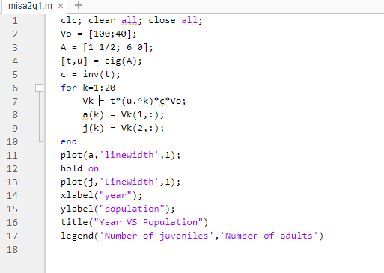
MATLAB CODE FOR SOLVING THE QUESTION:

Slide 9
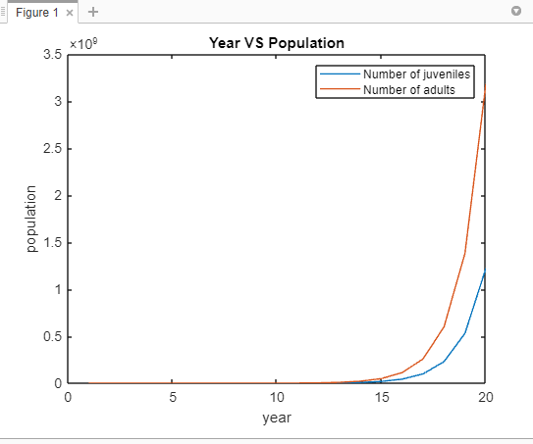
GRAPH AND OBSERVATION:
The number of adults and juveniles is increasing over the years.​
And the number of adult females increasing​
with more rate than the number of juvenile
females

Slide 10
02
“In the great temple at Benares, beneath the dome which marks the centre of the world, rests a brass-plate in which are fixed three diamond needles, each a cubit high and as thick as the body of a bee. On one of these needles, at the creation, God placed sixty-four discs of pure gold, the largest disc resting on the brass plate, and the others getting smaller and smaller up to the top one. This is the Tower of Bramah. Day and night unceasingly the priests transfer the discs from one diamond needle to another according to the fixed and immutable laws of Bramah, which require that the priest must not move more than one disc at a time and that he must place this disc on a needle so that there is no smaller disc below it. When the sixty-four discs shall have been thus transferred from the needle on which at the creation God placed them to one of the other needles, tower, temple,and Brahmins alike will crumble into dust, and with a thunderclap the world willvanish.”Find out the time required for the collapse of the world according to this myth.

Slide 11
TOWER OF HANOI :
The whole Tower Of Hanoi entails transporting n discs from source rod A to target rod C, with rod B serving as a backup. With mathematical induction, this strategy may be given a thorough mathematical proof, and it is frequently used as a recursion example when teaching programming.
We need to transfer all the discs to the final rods under the given constraints by obeying these rules;
Only one disk can be moved at a time.
Each move consists of taking the upper disk from one of the stacks and placing it on top of another stack i.e. a disc can only be moved if it is the uppermost disk on a stack.
No disk may be placed on top of a smaller disk.

Slide 12
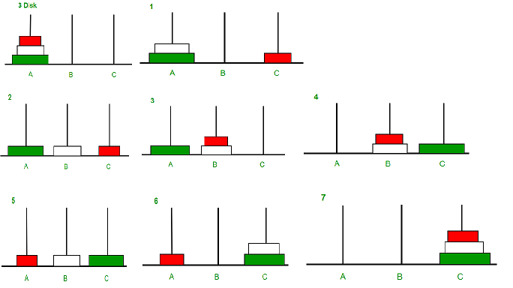
The number of moves taken here is seven, as seen in the diagram above. Following that, a repeated pattern can be used to demonstrate the maximum number of moves.

Slide 13
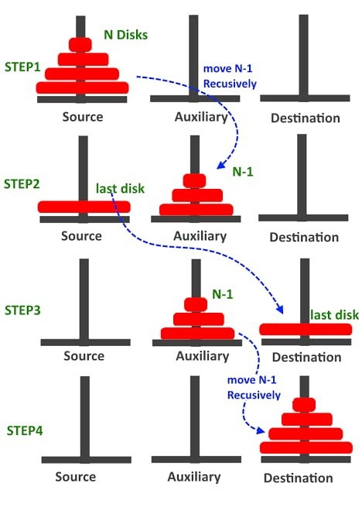
The minimum number of moves follows a pattern: 1,3,7,15,31,63....
So , here It follows a pattern 2^{n}-1

Slide 14
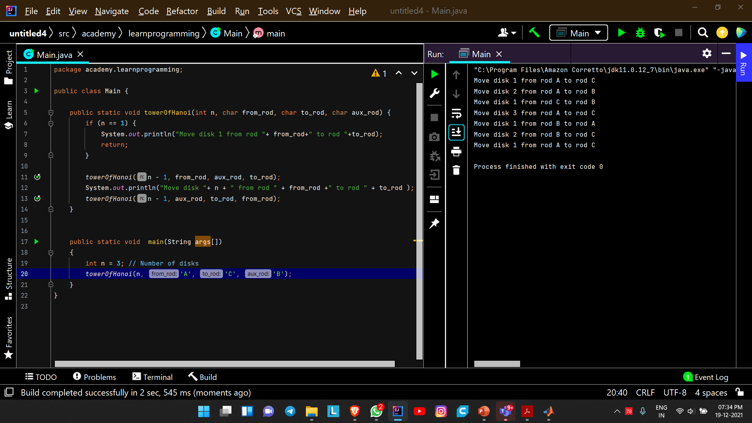
CODE FOR MOVING DISCS FROM SEVERAL RODS

Slide 15
OUTPUT :

Slide 16
APPLYING TOWER OF HANOI CONCEPT IN TOWER OF BRAMHA :
In the condition that each move takes a second,
Number of disk given is 64
We need to use the formula which we got before 2^{n}-1
TOTAL NUMBER OF MOVES FOR 64 DISCS = 2⁶⁴-1
So ,under the assumption that each move takes a second to solve 2⁶⁴-1 sec.
We need to convert these value into YEARS = (264-1) = 584942417355 YEARS
31536000
1 YEAR = 31536000 SECONDS

Slide 17
It would take 584942417355 YEARS for the world to vanish according to this myth ( if each moves takes a second) if our computer solves at a rate a Of 1000 moves per sec then it will take 584942417 YEARS 3 MONTHS.

Slide 18
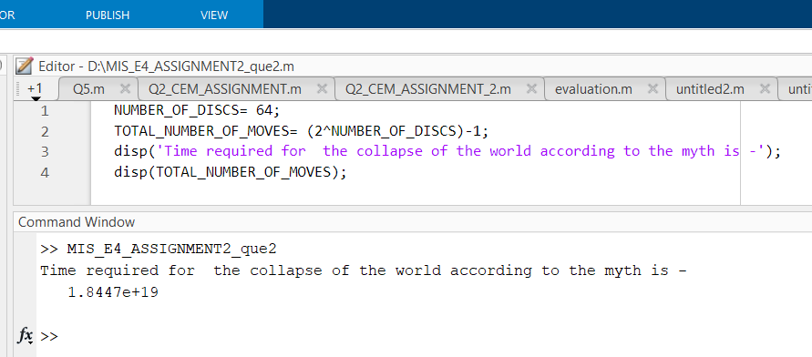
MATLAB CODE :

Slide 19
03
3. Use PCA to do the dimensionality reduction from 4 parameters to 2 parameters on the Iris excerpt dataset https://amritavishwavidyapeetham.sharepoint.com/:x:/s/B.Tech.2021.R.AIE.1.19MAT105/EQYHkcctZZtAs236nWHJeokB02n9kdJ1Jx4mJtcvrIiogw?e=c6NihO (An excerpt of Iris dataset from Kaggle). Use SVD to do the PCA and data reduction.

Slide 20
Ans
Taking iris excerpt from the question mentioned and applying concept of Principal Component Analysis(PCA) to reduce the dimensionality of data.
In the data we are given with sepal length, sepal width, petal length and petal width and from the given data we are going to choose most important data which causes most changes and will neglect the data where data variance is not much.
We will do the same using MATLAB:

Slide 21
Explanation

Slide 22
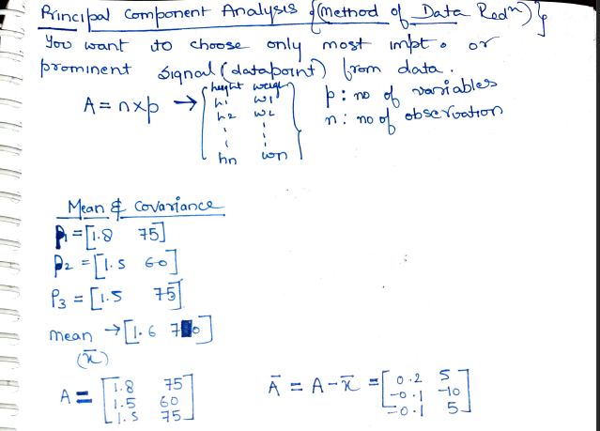
Explanation

Slide 23
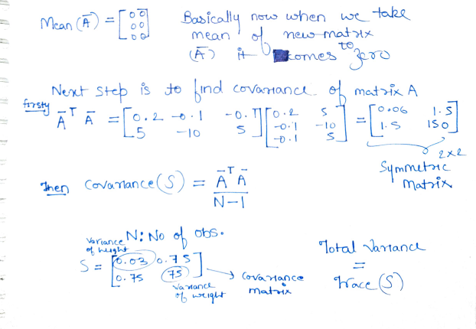
Explanation

Slide 24
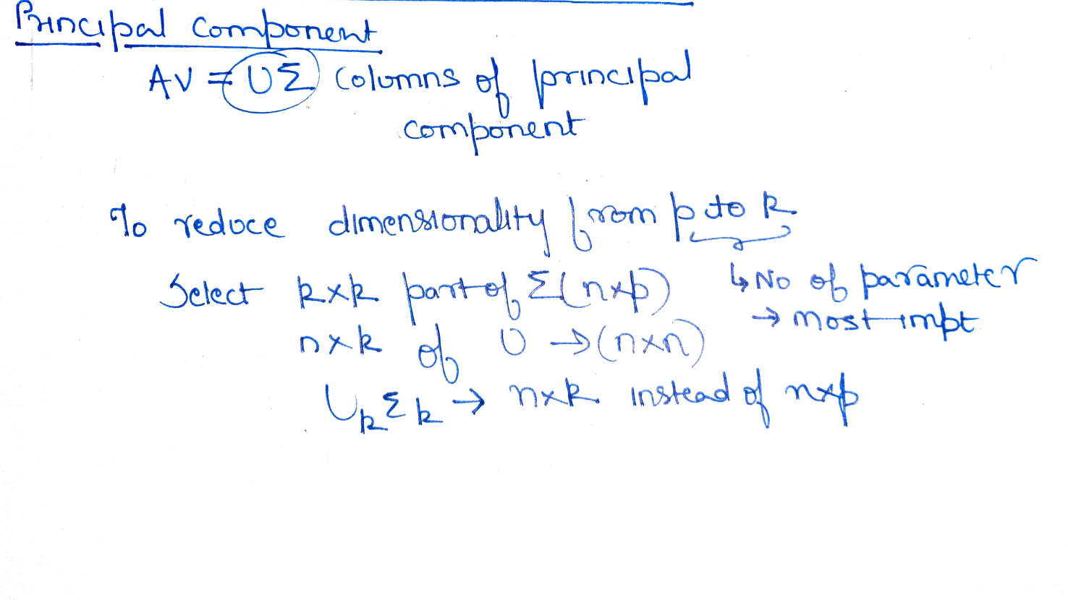
Explanation

Slide 25
MATLAB CODE

Slide 26
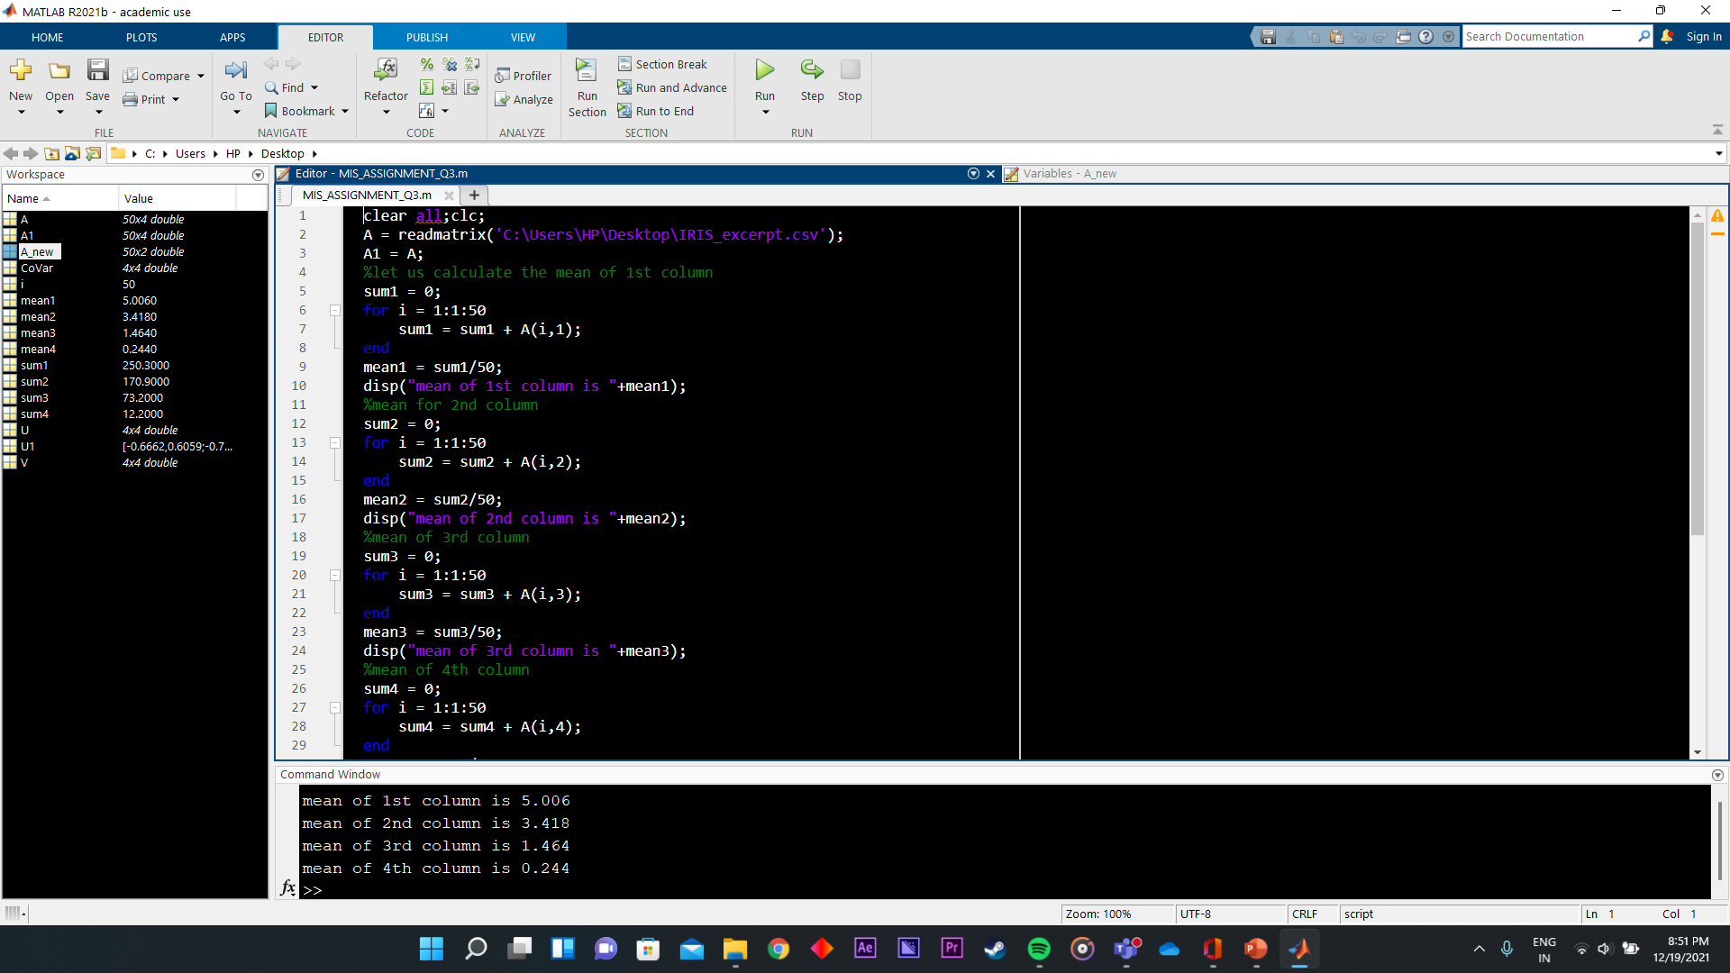

Slide 27
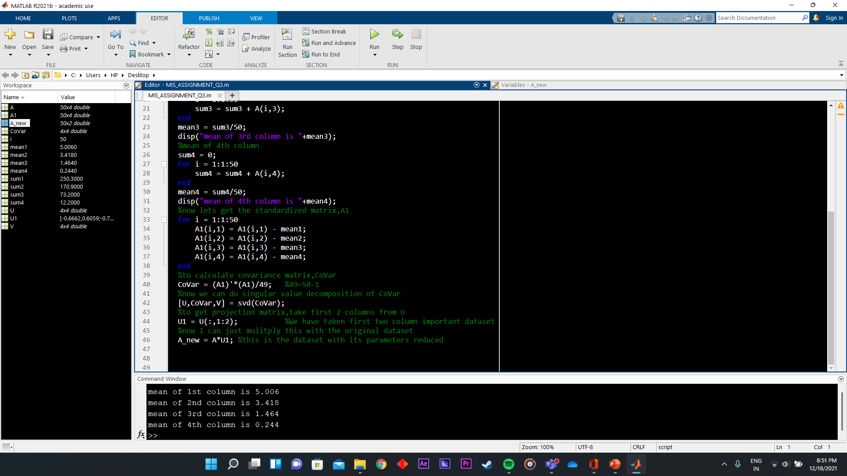

Slide 28
Reduced Dimensionality

Slide 29
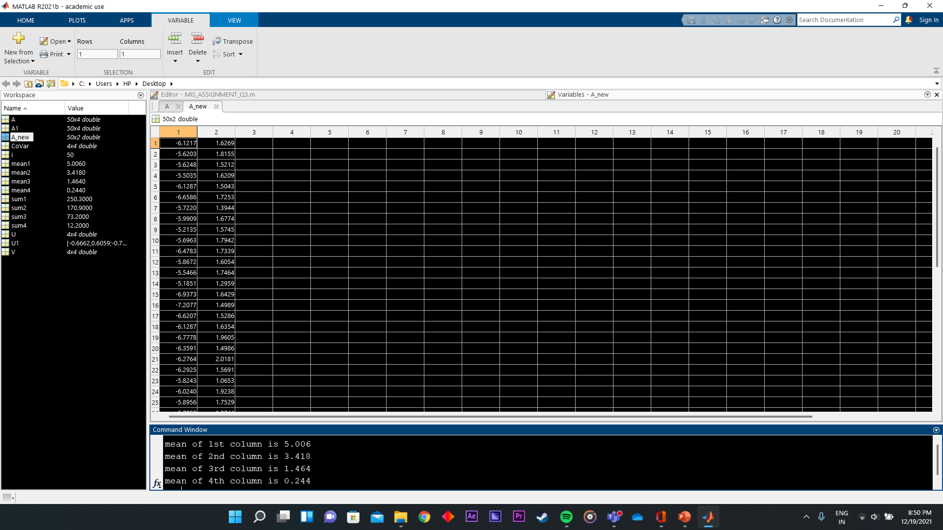

Slide 30
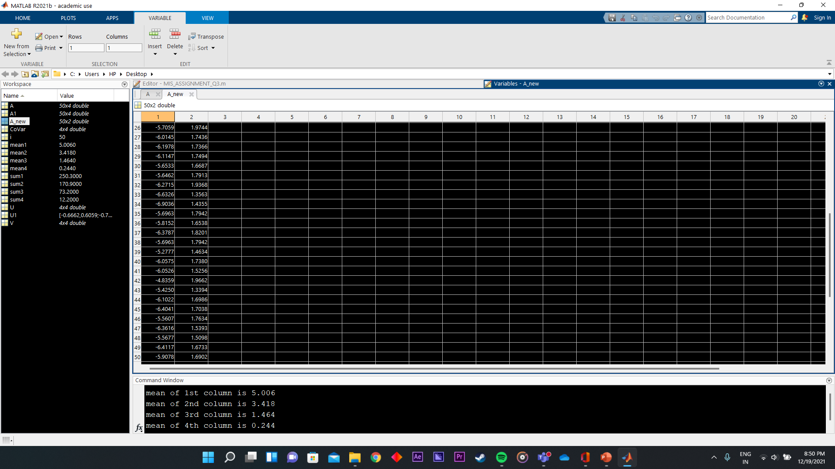

Slide 31
04
4. Use the Projection matrices (least square fit) to fit a straight line to the reduced dataset obtained from the PCA data reduction problem. Report the intercept and slope of the line for the straight line obtained in the form of equation of a straight line.

Slide 32
Solution:
From the previous question we get the data points which are in the form of a matrix of 50by2.
We use Matlab to show the matrices using least square fit method.
We use the method Ax = b
Here matrix A equals to
A=[-6.3443 1; -5.9096 1;-5.8356 1; -5.7474 1; -6.3190 1; -6.8823 1; -5.8925 1; -6.2326 1; - 5.4539 1; -5.9839 1; -6.7179 1; -6.0957 1; -5.8255 1; -5.3545 1; -7.1330 1; -7.3504 1; - 6.7887 1; -6.3482 1;-7.0640 1;-6.5362 1; -6.6001 1; -6.4853 1; -5.9048 1; -6.3165 1; - 6.1659 1; -6.0365 1;-6.2639 1; -6.4478 1; -6.3696 1; -5.9058 1;-5.9311 1; -6.5612 1; - 6.7731 1; -7.0490 1; -5.9839 1;-6.0527 1; -6.6415 1; -5.9839 1; -5.4854 1; -6.3128 1; - 6.2447 1; -5.1854 1; -5.5951 1; -6.3266 1; -6.6337 1;-5.8334 1; -6.5557 1; -5.7788 1; - 6.6378 1; -6.1544 1;]

Slide 33
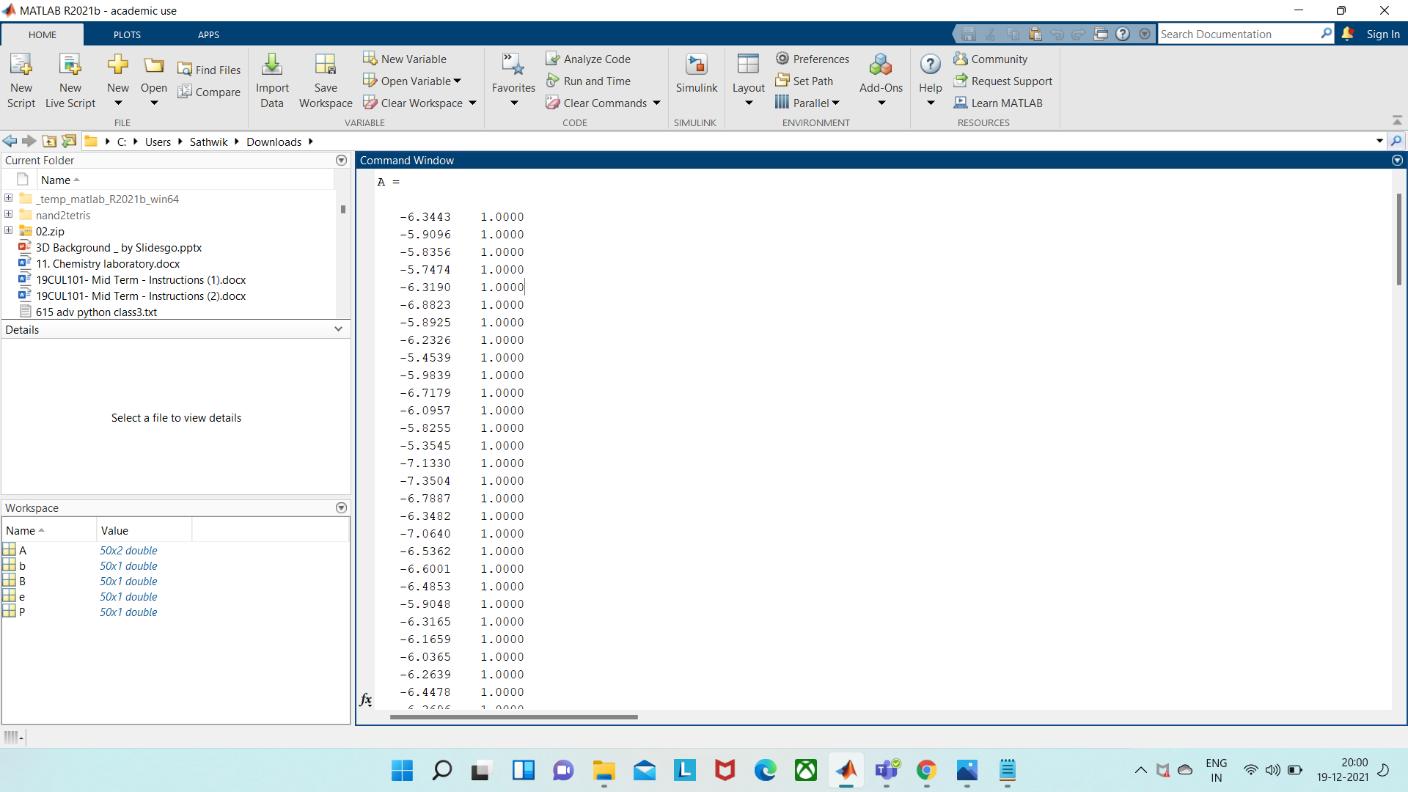
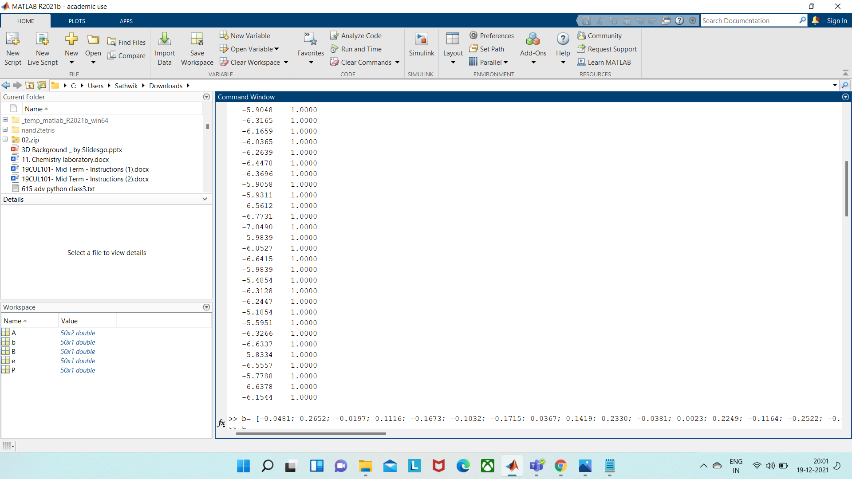
After running the matrix, A code in Matlab, we get

Slide 34
Matrix b
After running the matrix, b code in Matlab, we get
b= [-0.0481; 0.2652; -0.0197; 0.1116; -0.1673; -0.1032; -0.1715; 0.0367; 0.1419; 0.2330; -0.0381; 0.0023; 0.2249; -0.1164; -0.2522; -0.4689; -0.2889; -0.0483; 0.0970; -0.2383; 0.2912; -0.1596; -0.5146; 0.2483; 0.1416; 0.3984; 0.0828; 0.0387; 0.0711; 0.1196; 0.2388; 0.1980; -0.4340; -0.4382; 0.2330; 0.0551; 0.0671; 0.2330; 0.0167; 0.0772; -0.1351; 0.6086;-0.1409; 0.0037; -0.0528; 0.2246;-0.1917; -0.0137; -0.0785; 0.0691];

Slide 35
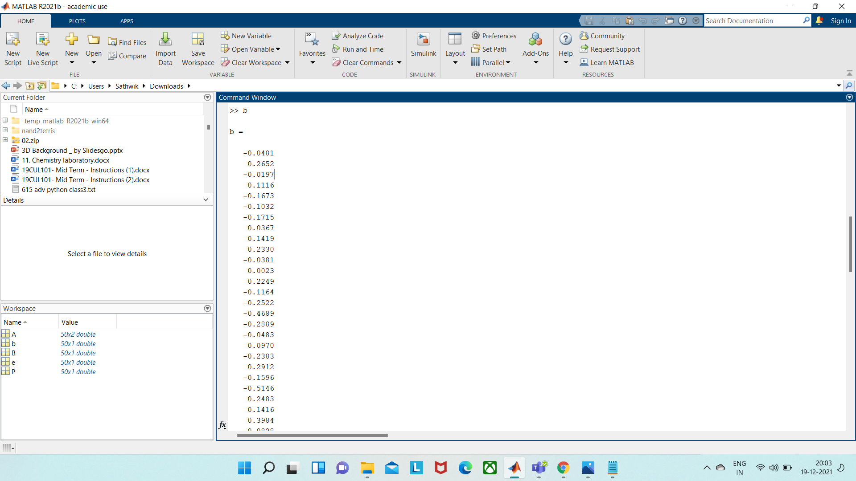
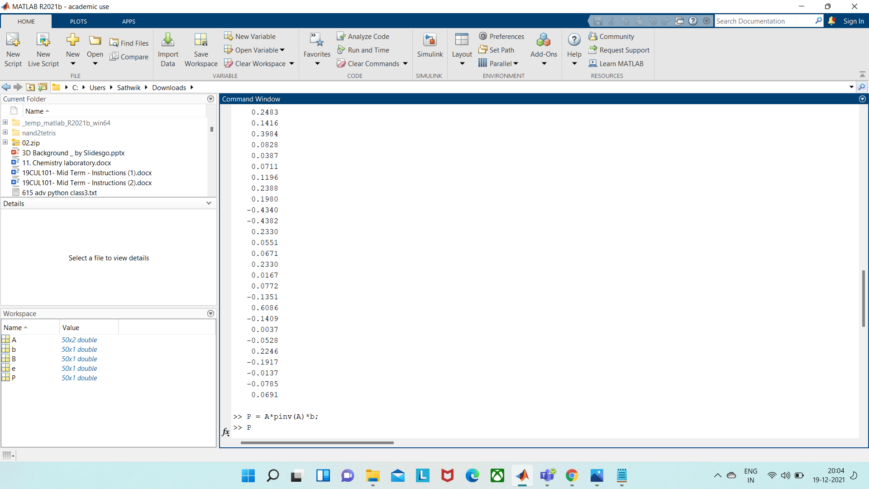
After running the matrix, b code in Matlab, we get

Slide 36
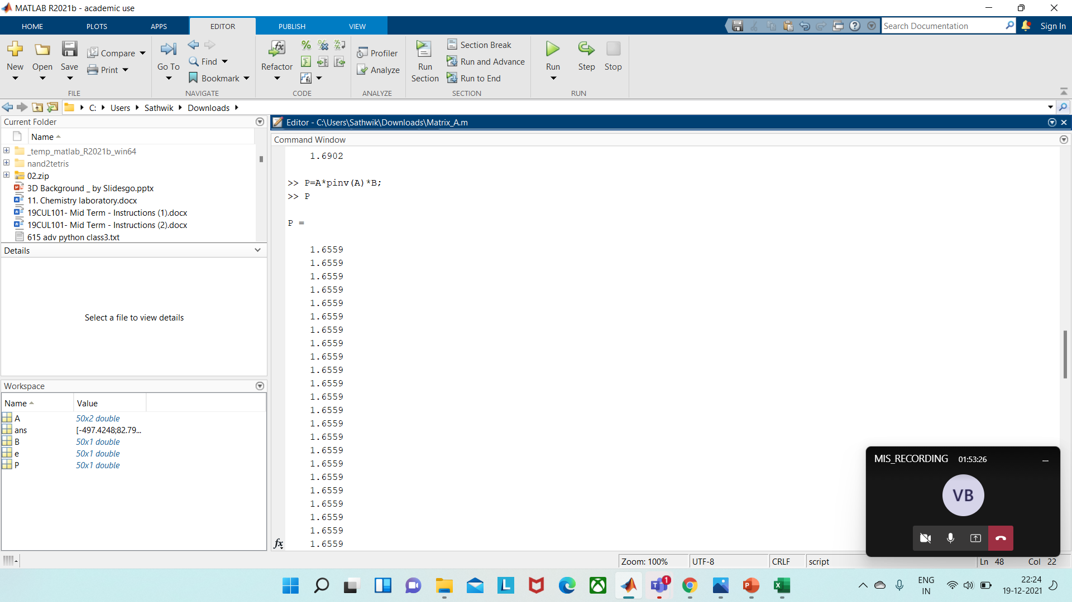
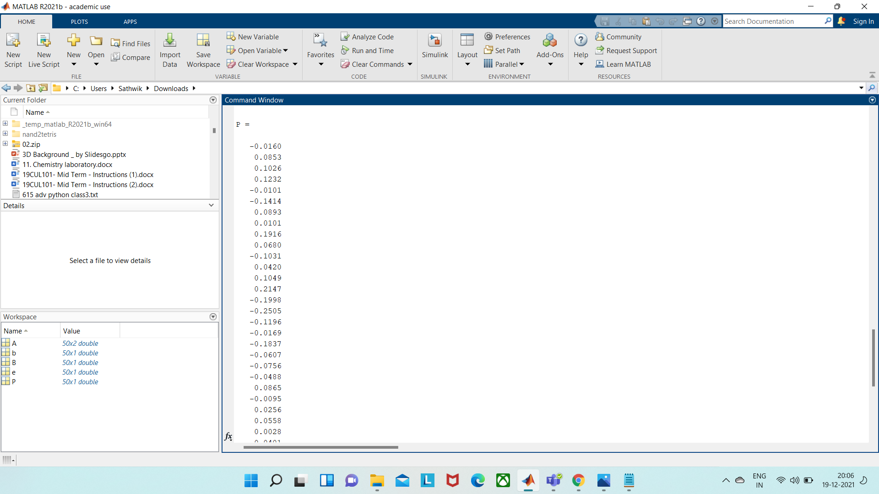
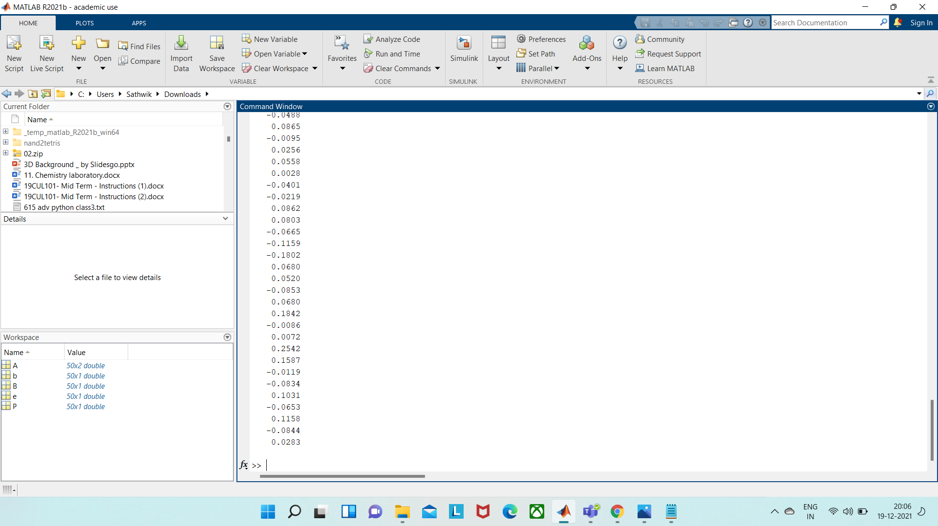
Now Using Matlab use the formulae below to get the projection of b on A.
>>P = A*pinv(A)*b;
>>P

Slide 37


Now we've to find the error using the following formulae
>> e =b-P;
>>e

Slide 38
Using this following command, we get that e is in the left null space.
>>X=A'*e;
>>X
1.0e-12*
0.1785
-0.0285

Slide 39
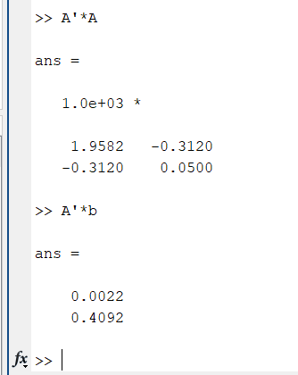
Now we've to find the slope and intercept of the line.
To find them first we've to find the product of A' and A which will be a symmetric matrix. Now we've to find the product of A' and b which will act as constant in the equations.

Slide 40
Now from the equations by the following :
Let A'*A be as matrix 'q' and matrix A'*b as matrix 's' and let matrix'p'be [m;c]. Here m is the slope and c is the intercept.
q*p=b is the way we get the equation which when we solve get the slope and intercept.
We get the equations as :
1.9582m-0.3120c=0.0022------(1)
-0.3120m+0.050c=0.4092-------(2)
On solving the eq we get
m=225.760
c=1416.929
So, we can substitue these values in the line equation y=mx+c
Therefore, the line eq is y =225.76x+1416.929

Slide 41
THANKS!

Slide 42
Fonts & colors used
This presentation has been made using the following fonts:
Oswald
(https://fonts.google.com/specimen/Oswald)
Titillium Web
(https://fonts.google.com/specimen/Titillium+Web)
#020304
#666056
#9e9d9d
#dbb083
#e4ccb3
#9e2020

